Slide 1



Insurance Markets and Risk Trends in 2016
FEBRUARY 2016

Slide 2
INSURANCE MARKETS AND RISK TRENDS IN 2016
PROPERTY
Organizations without major CAT exposure: favorable terms and conditions,
rate decreases of 5% to 15% in 2016.
CAT-exposed organizations: 10% to 15% rate reductions, depending on risk profiles.
All insureds: scrutiny of flood, storm surge, and CBI coverage terms and conditions.
COVERAGE | SEGMENT | RATE CHANGE Q4 2015 | RATE CHANGE Q4 2014
Property | Non-CAT-exposed organizations | 10% decrease to 5% decrease | 10% decrease to flat
 | Moderately CAT-exposed organizations (1% to 30% of values in cat zones) | 15% decrease to 5% decrease | 10% decrease to flat
 | Largely CAT-exposed organizations (more than 30% of values in cat zones) | 15% decrease to 5% decrease | 10% decrease to flat
 | Loss-driven organizations | Variable | Variable
The above represents the typical rate change at renewal for average / good risk profiles.

Slide 3
INSURANCE MARKETS AND RISK TRENDS IN 2016
INSURER M&A AND CAPACITY
Five large deals involving property insurers announced in 2015.
  No major impact on competition and capacity to date.
Existing insurers:
  Increased underwriting capacity.
  Increased availability for named windstorm, storm surge, and earthquake risks.
  Continued scrutiny of high-hazard flood risks.
  Expanded capacity at pricing aimed at dislodging competitors.
Casualty insurers looking to cut costs and create synergies.
  Larger insurers likely to acquire specialty carriers.
Foreign insurers continue to emerge in the US.

Slide 4
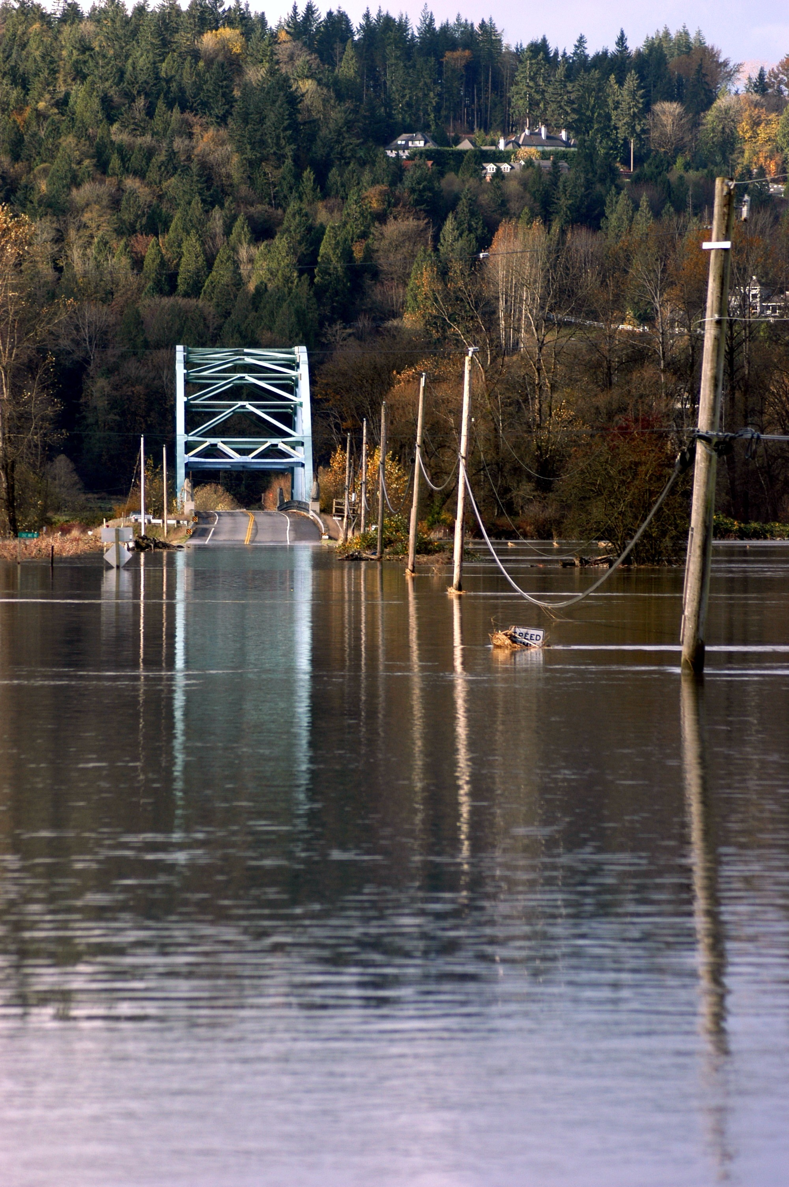
INSURANCE MARKETS AND RISK TRENDS IN 2016
KEY PROPERTY CONSIDERATIONS
Flooding remains the top natural catastrophe risk for US property owners.
Insureds should review flood coverage
items, including:
  Where storm surge is/is not covered.
  Special Flood Hazards Area (SFHA) limits.
  Deductibles.
  How locations are defined as in/out of
  SFHA zones.
Review/update business continuity and crisis management plans.
Insurers more open to granting additional/
unique coverages:
  Lower percentage deductibles for CAT perils.
  Improved terms and conditions to keep premium rates flat.

Slide 5
INSURANCE MARKETS AND RISK TRENDS IN 2016
CONTINGENT BUSINESS INTERRUPTION
Contingent business interruption (CBI) is challenging, particularly for organizations with large supply chain networks.
CBI coverage rates are ultimately determined from suppliers’ underwriting information, which can be difficult for companies to obtain.
“All-risk” policies often provided extensions for CBI, however, only for the perils that the policy insures.
Cyber Considerations
  Business interruption is the big question of the day from many clients.
  Companies are increasingly exposed to cyber threats, including partial impacts and extra expenses.
  Will be a key issue in 2016.

Slide 6
INSURANCE MARKETS AND RISK TRENDS IN 2016
RENEWAL MARKETING STRATEGY
Start early.
Be prepared with high-quality data.
Present a clear risk management philosophy.
Consider both traditional and non-traditional capacity.
Be realistic.
Consider multi-year options.
Evaluate long-term partnerships with insurers.

Slide 7
INSURANCE MARKETS AND RISK TRENDS IN 2016
CASUALTY MARKET CONDITIONS
Casualty market softened in 2015.
Strong competition and capacity.
  Difficult for insurers to secure rate increases.
How low can rates go?
  Current rates barely cover loss trends.
  Insurers’ results remain under pressure.
  Increasing exposures have offset the effects of rate decreases.
Favorable market conditions expected to continue in 2016.

Slide 8
INSURANCE MARKETS AND RISK TRENDS IN 2016
CASUALTY MARKET RATES
COVERAGE | SEGMENT | RATE CHANGE Q4 2015 | RATE CHANGE Q4 2014
General Liability | Guaranteed cost | 10% decrease to 5% increase | 10% decrease to 5% increase
 | Loss sensitive | 10% decrease to 5% increase | 5% decrease to 5% increase
Automobile Liability | Guaranteed cost | 10% decrease to 5% increase | 5% decrease to 10% increase
 | Loss sensitive | 10% decrease to 5% increase | 5% decrease to 10% increase
Umbrella and Excess Liability | Lead | 5% decrease to 5% increase | Flat to 5% increase
 | Excess layers | 10% decrease to 5% increase | Flat to 5% increase
Workers’ Compensation | Guaranteed cost | 10% decrease to flat | 5% decrease to 5% increase
 | Loss sensitive | 10% decrease to 5% increase | 5% decrease to 5% increase

Slide 9
INSURANCE MARKETS AND RISK TRENDS IN 2016
SAFETY TRENDS: WEARABLE TECHNOLOGY
Wearable technology increasingly used by employers to prevent workplace injuries.
  Tracks employee movements in real time.
  Warns supervisors and peers when employees are in danger.
  Helps identify unsafe working conditions and other trends.
  Some concern over privacy.
Employers becoming more creative in the design of wellness programs.
  Mercer study: one-quarter of large employers encourage employees to track activity with wearable devices.
  Scope of wellness programs broadening.

Slide 10

INSURANCE MARKETS AND RISK TRENDS IN 2016
DRONES
Used by individuals and businesses for a variety of purposes.
Usage expected to continue to increase.
Insurers concerned about potential risks to drone operators:
  Personal and advertising injury.
  Bodily injury.
  Property damage.
Underwriters seeking more information about drone size and intended purpose.

Slide 11
INSURANCE MARKETS AND RISK TRENDS IN 2016
DIRECTORS AND OFFICERS (D&O) LIABILITY
SEGMENT | RATE CHANGE Q4 2015 | RATE CHANGE Q4 2014
Public companies | 10% decrease to flat | 2% decrease to 2% increase
Private companies | 5% decrease to 5% increase | Flat to 15% increase
The above represents the typical rate change at renewal for average / good risk profiles.
D&O PRICING
D&O pricing for commercial risks continued to fall in 2015,
driven by insurer competition.
Downward pressure on rates expected to continue in 2016.

Slide 12
INSURANCE MARKETS AND RISK TRENDS IN 2016
WAGE AND HOUR
New FLSA overtime rules expected to increase the number of employees entitled to overtime.
Court decisions and DOL guidance has found workers to be employees rather than
independent contractors.
Ruling in NLRB v. Browning Ferris Industries of Pennsylvania expands concept of
“joint employer.”
Legislation in California and New York allows directors, officers, and shareholders to be held liable for wage and hour violations.
Source: Seyfarth Shaw LLP

Slide 13
INSURANCE MARKETS AND RISK TRENDS IN 2016
WAGE AND HOUR
Most-targeted industries:
  Retail.
  Financial services.
  Food / food services.
  Construction.
  Health care.
  Staffing agencies.
Best practices:
  Stay abreast of changing wage and hour laws.
  Conduct regular audits.
  Ensure proper classification of employees.
  Consider wage and hour insurance.

Slide 14
INSURANCE MARKETS AND RISK TRENDS IN 2016
MANAGING POLITICAL RISK
Protect employees:
  Crisis planning to ensure effective communication during a crisis.
Manage credit risk:
  Review credit-control policies and procedures.
  Evaluate potential impact of political risk on their operators and those of customers and suppliers.
Build resilient supply chains:
  Understand single points of failure.
  Consider alternative suppliers and ports.
Consider purchasing insurance:
  Multi-country policies can provide coverage for several risks across a region or for a list of countries.
Trouble spots:
  Turkey.
  Brazil.
  Russia.
  Sub-Saharan Africa

Slide 15
INSURANCE MARKETS AND RISK TRENDS IN 2016
CYBER RISK
SEGMENT | RATE CHANGE Q4 2015 | RATE CHANGE Q4 2014
Cyber | Flat to 10% increase | 2% increase to 10% increase
Retail | Flat to 50% increase | Flat to 10% increase
Health care | Flat to 15% increase | Flat to 5% increase
The above represents the typical rate change at renewal for average / good risk profiles.
Critical factor: Have underwriters reviewed your account in the past two years?
Price increases blunted by steady flow of capacity.
No easy answer to how much cyber insurance to purchase.

